Slide 1
National Honor Society in Action!
Using our time and talents to serve others!

Slide 2
This year we have been busier than ever!
Check our some of our activities!
You’ll be surprised how visible we are this year!

Slide 3
Upcoming Service
Marshall County Chamber of Commerce
Business Expo in March
Ladies’ Night in April
CASA (Court-Appointed Special Advocates)
Superhero 5K in April

Slide 4
Completed Service
John Marshall Cross Country Invitational
Marshall County Chamber of Commerce
Christmas Tree Gala Set-up
Tree Gala Auction
Tree package and removal
Family Resource Network Gift Packages
Paws for a Cause Shopping and Fundraising
Salvation Army bell-ringing
A&B Kia County Kids Christmas Party

Slide 5
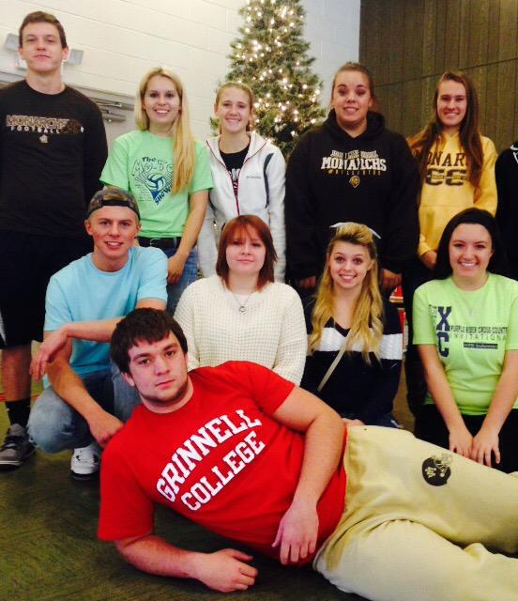
Members assembled more than 20 trees for the Marshall County Chamber of Commerce annual Christmas Tree Gala.

Slide 6
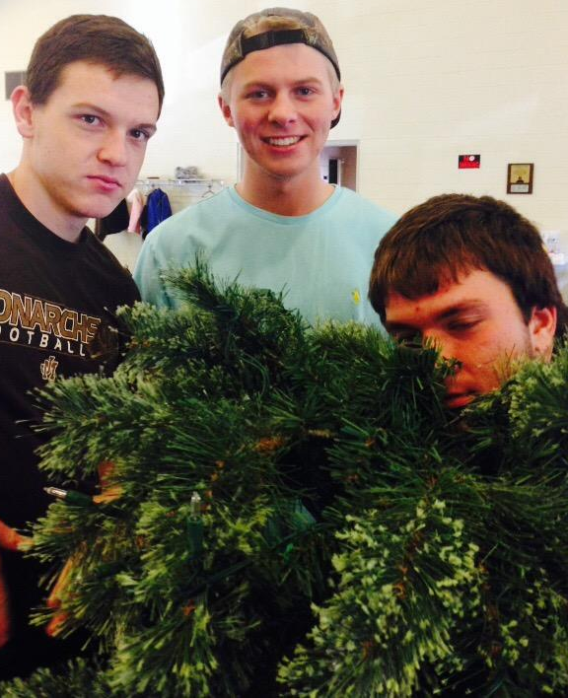

Slide 7
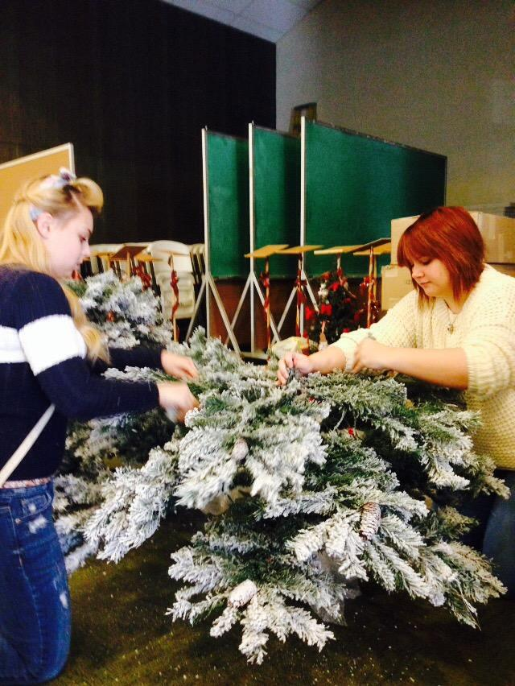

Slide 8
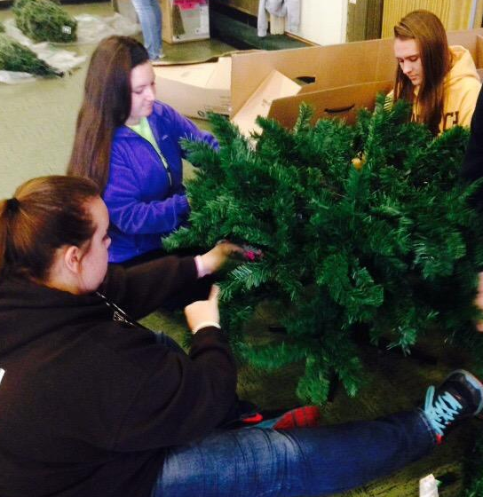
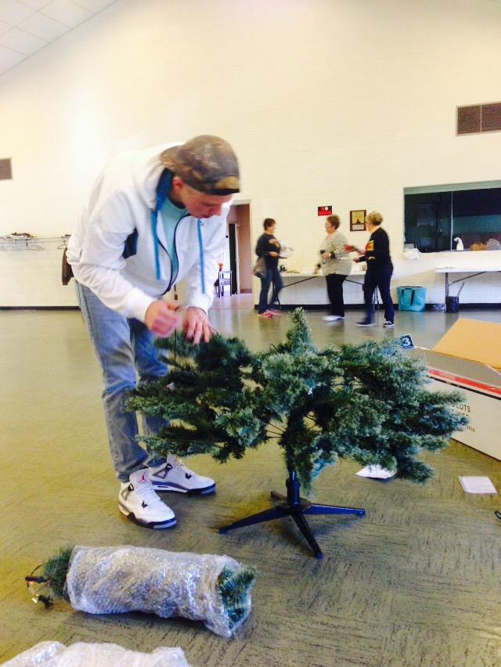

Slide 9
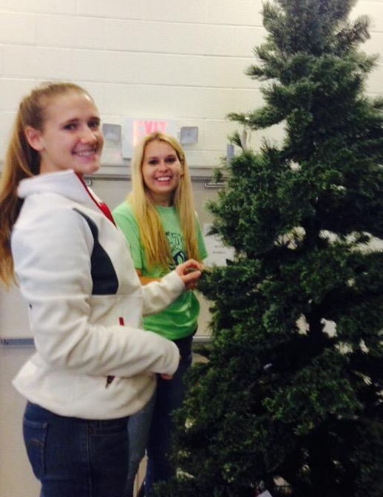
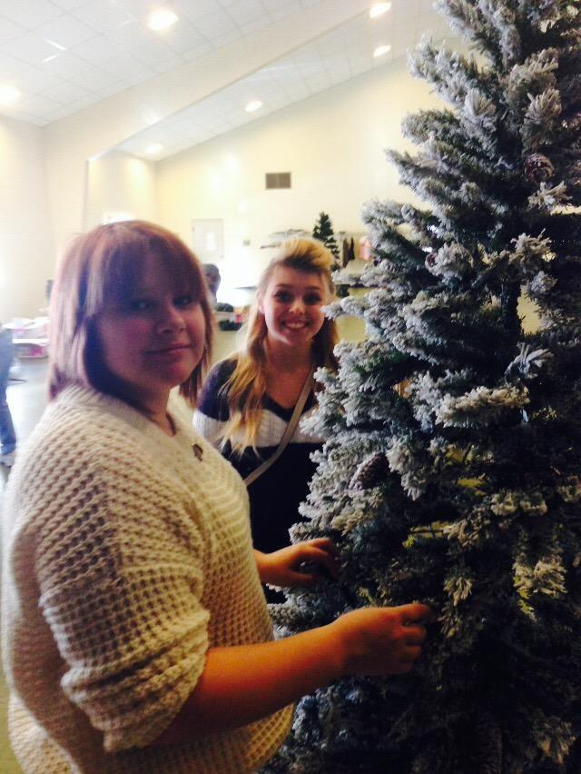
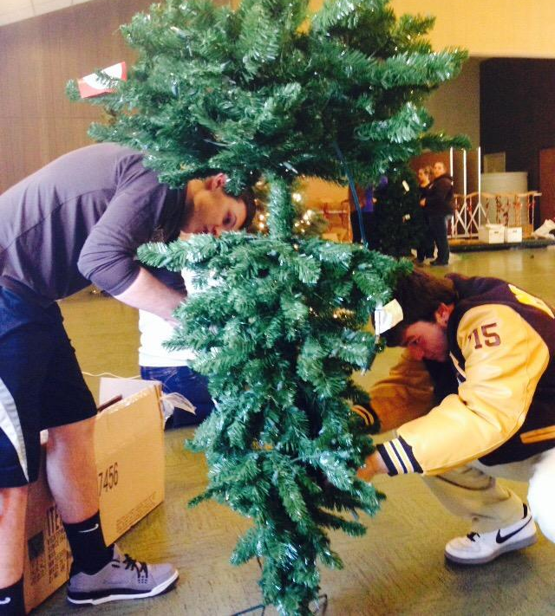

Slide 10
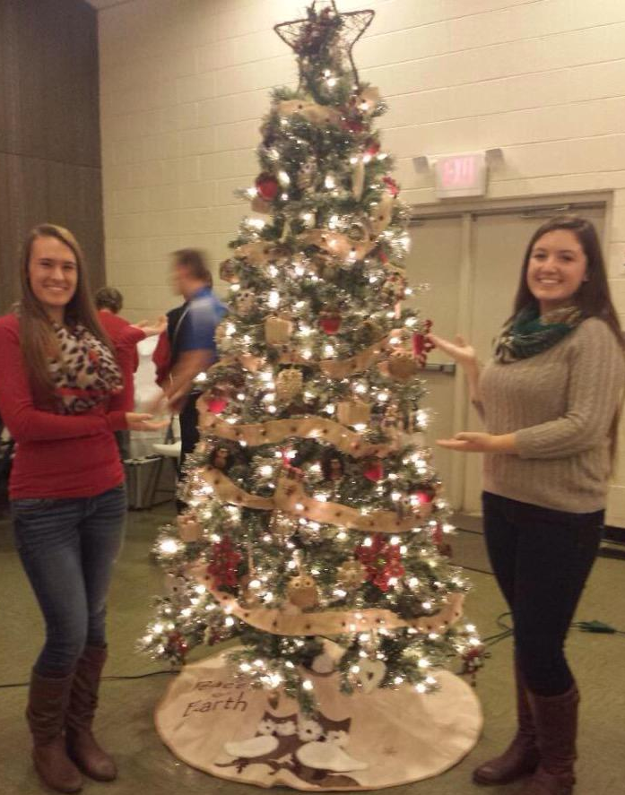
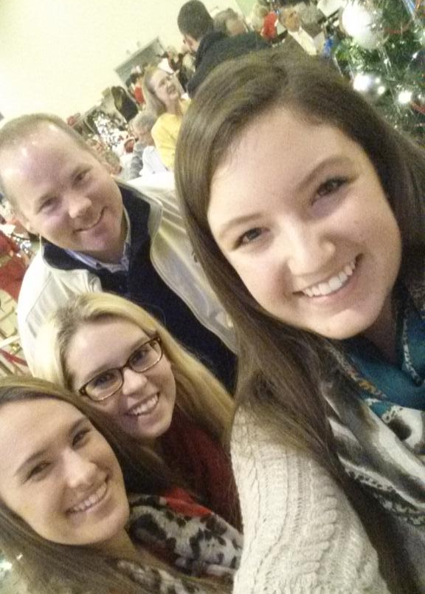
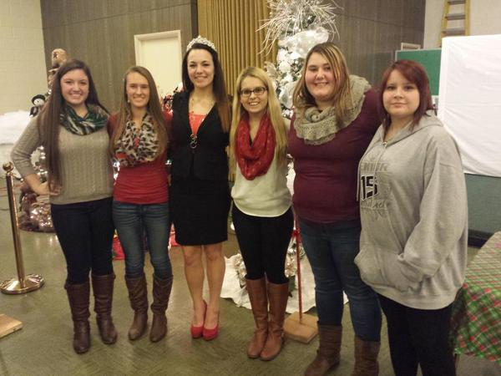
Members also volunteered to work at the Marshall County Chamber of Commerce Christmas Tree Auction.

Slide 11
And then they packaged up the more than 20 trees to be delivered to auction winners.

Slide 12
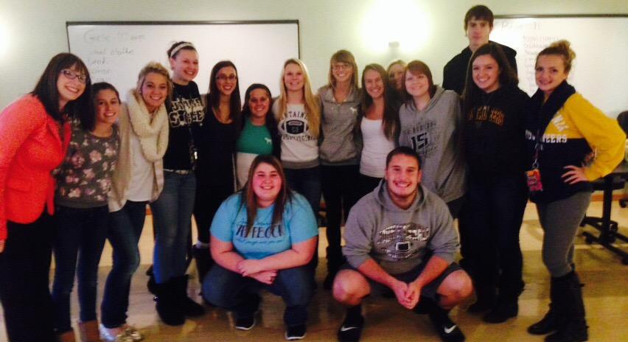
Members packaged Christmas gifts for the Marshall County Family Resource Network. These gifts were given to high school students at Bishop Donahue, Cameron, and John Marshall High Schools.

Slide 13
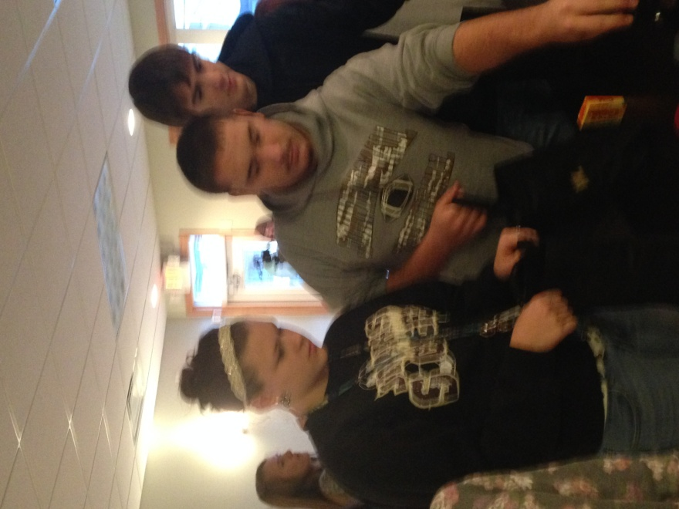
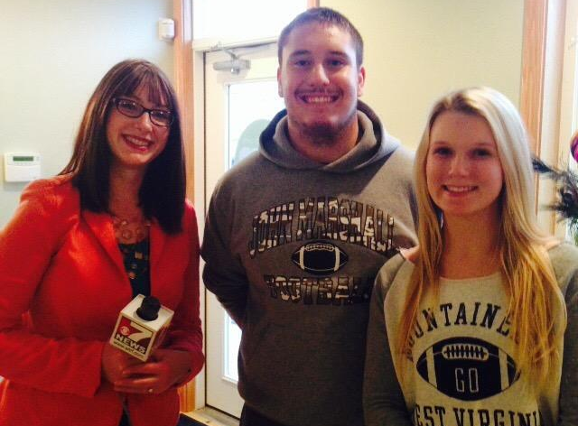
Katrina Malstrom interviewed JM National Honor Society Executive Committee Members Thad Herback and Jackie Gellner about the FRN project.

Slide 14
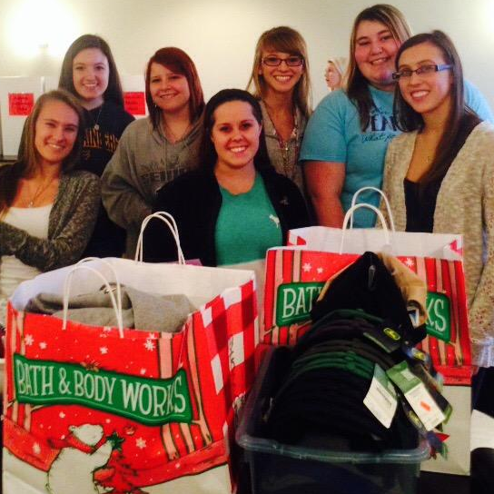

Slide 15
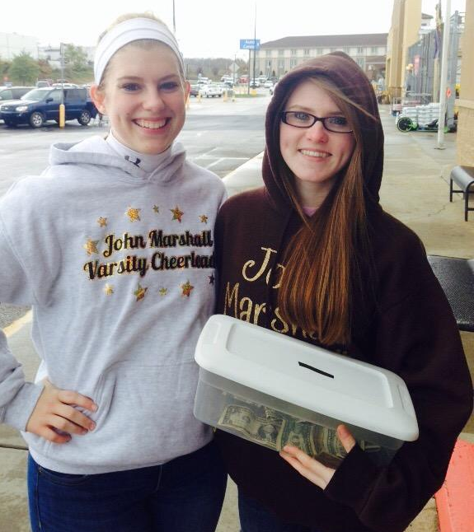
Volunteering for the
Family Resource Network
Tag Day.

Slide 16
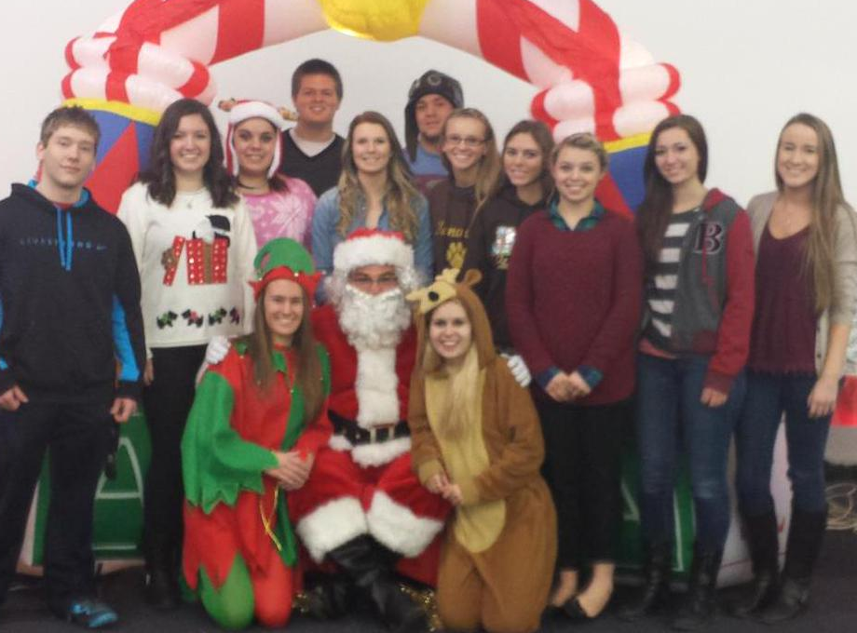
Members volunteered at the A&B Kia Marshall County Kids Christmas Party where hundreds of Marshall County school students received presents.

Slide 17
Members Allison and Kolleen help Santa at the event.

Slide 18
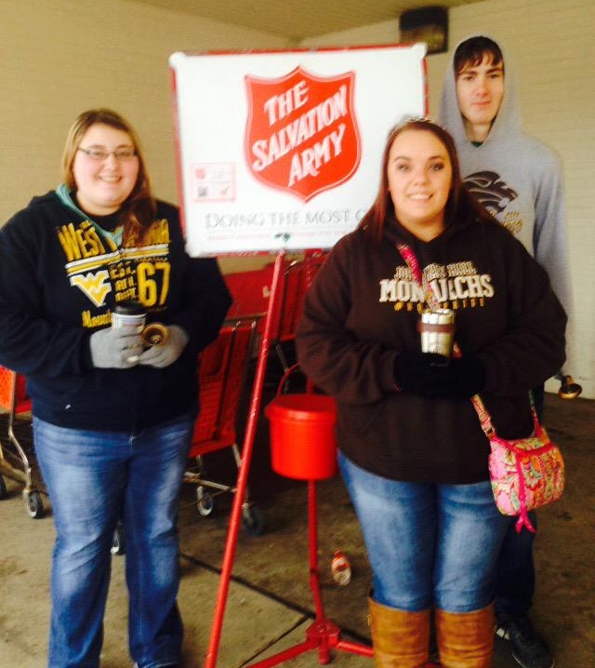
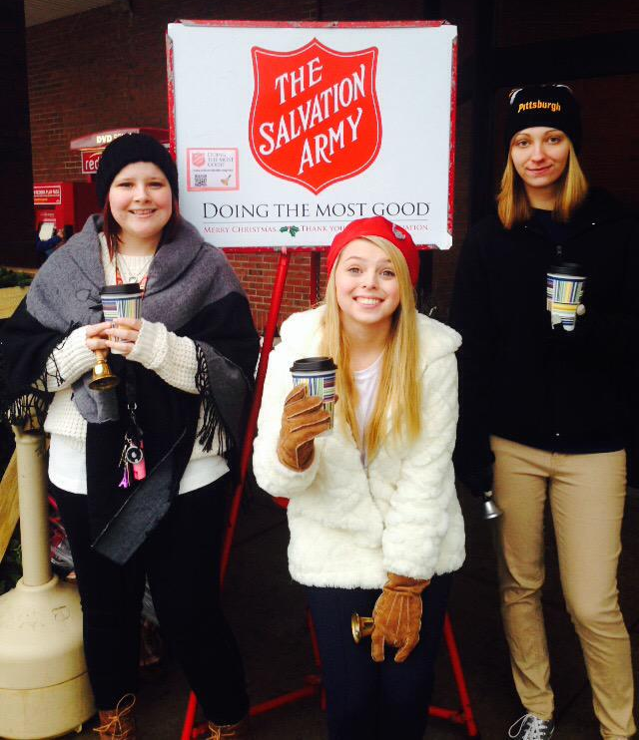
Salvation Army Bell-ringing

Slide 19
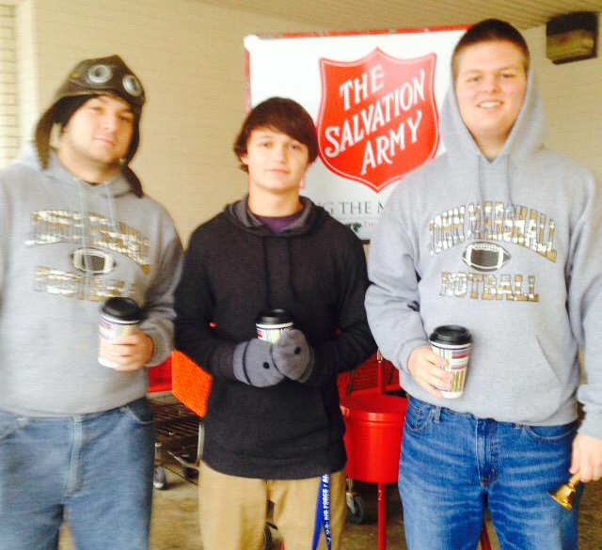
Members spent some cold hours during the holiday season ringing bells outside of
Kroger
Save-A-Lot
and
Goddard’s Exxon.
One of Santa’s elves supplied them some hot cocoa with marshmallows! Yum!

Slide 20
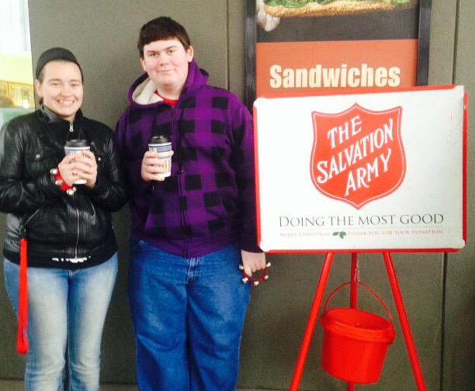
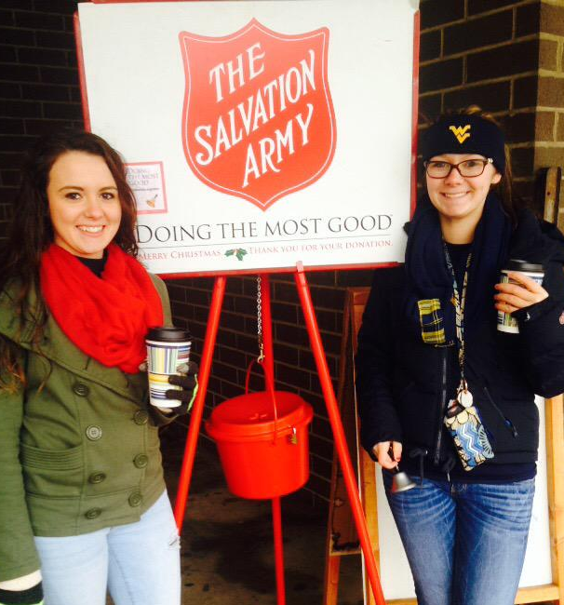

Slide 21
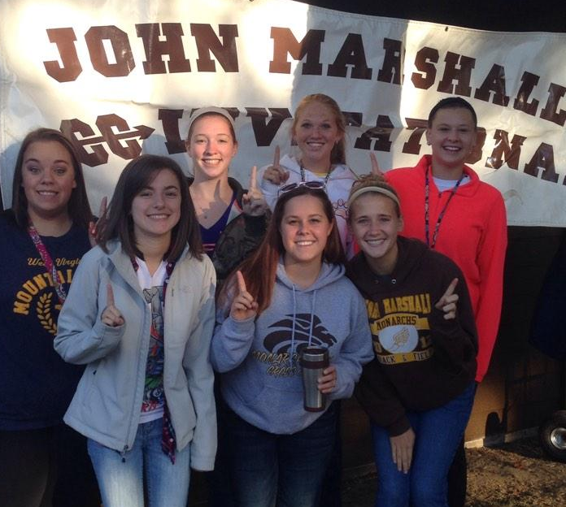
Members volunteered at the John Marshall High School Cross Country Invitational.

Slide 22
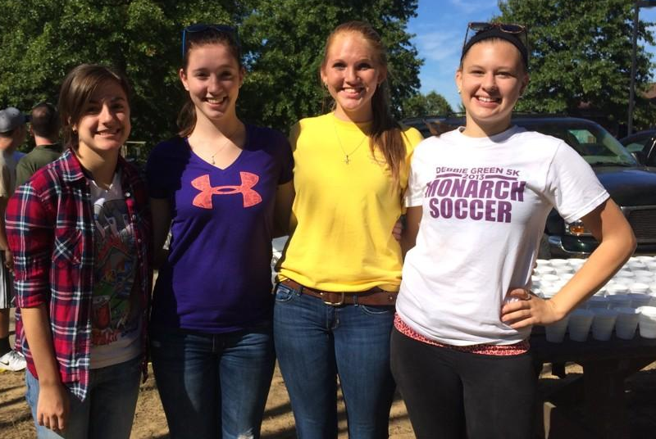

Slide 24
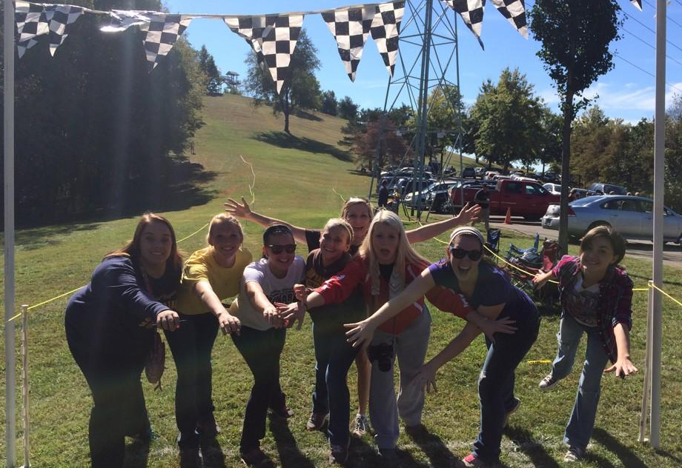
Are you ready to serve?

